Slide 1

Student Performance Prediction
A Regression AI Project: Practical Evaluation Presentation
This presentation details the development and evaluation of a regression-based AI model designed to predict student academic performance. We will explore the methodologies, tools, and findings of this project, aiming to provide valuable insights for educators and institutions.

Slide 2
Introduction to the Project
This project centers on developing a regression-based AI model to predict student academic outcomes. Our model analyzes various independent features, including study hours, sleep duration, previous academic scores, attendance, and co-curricular involvement. The primary objective is to generate a custom 'Performance Index' that serves as a predictive grade, enabling educators to proactively identify at-risk students and refine learning strategies for improved educational effectiveness.
1
Model Objective
2
Key Features
Build a regression AI model to predict student academic performance using various input features.
Study hours, sleep duration, previous academic scores, attendance, and co-curricular involvement.
3
Target Variable
4
Impact
A custom 'Performance Index' representing the student's expected output or grade.
Help educators identify struggling students and optimize learning strategies.

Slide 3




Libraries & Methods Utilized
Our project leveraged a suite of specialized Python libraries, each serving a distinct purpose in the AI development pipeline. Pandas and NumPy were essential for robust data manipulation, while Matplotlib and Seaborn facilitated comprehensive data visualization. Scikit-learn provided the core machine learning functionalities, from model training to evaluation. Imblearn was crucial for balancing our dataset, and Category_encoders enabled efficient handling of categorical variables through methods like Target Encoding, enhancing model interpretability and performance.
Pandas & NumPy
Matplotlib & Seaborn
Scikit-learn
Imblearn & Category_encoders
For efficient data manipulation and numerical processing.
For advanced data visualization and graphical analysis.
Key functions for machine learning, including model training and evaluation.
For data balancing via undersampling and efficient categorical variable encoding.

Slide 4


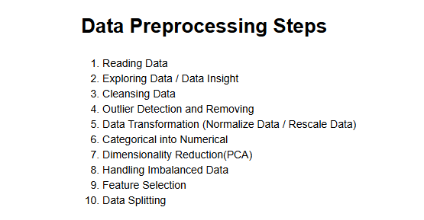



Comprehensive Data Preprocessing
Data preprocessing was a critical phase to ensure the quality and suitability of our dataset for model training. Missing values were systematically handled using a mean imputation strategy, preserving data integrity. Outliers were identified and removed using the Interquartile Range (IQR) method, mitigating their potential negative impact on model accuracy. To address class imbalance, random undersampling was applied, creating a more balanced dataset. Finally, categorical features were encoded using TargetEncoder, optimizing them for improved model interpretability and predictive power, and the dataset was rigorously checked for consistency.
Missing Value Imputation
Handled using mean imputation for model compatibility.
Outlier Detection & Removal
Applied the IQR method to ensure robust data.
Dataset Balancing
Achieved through random undersampling to eliminate class bias.
Categorical Encoding
Utilized TargetEncoder for enhanced model interpretability.
Final Consistency Check
Ensured data readiness before model training.

Slide 5




Core Code & Model Setup
The core of our AI project involved meticulous preparation of the dataset for model training. We first separated the dataset into the feature set (X) and the target variable (y), setting the stage for supervised learning. A crucial step was performing a train-test split with a 70/30 ratio, which allowed us to rigorously evaluate the model's generalization capabilities on unseen data. The LinearRegression model from scikit-learn was then initialized and fitted to the training data. Post-fitting, we extracted and analyzed the model coefficients to gain insights into the contribution of each feature towards student performance prediction.
Dataset Separation
Divided into feature set (X) and target variable (y).
Train-Test Split
70/30 ratio used for robust performance evaluation.
Model Initialization
LinearRegression model from scikit-learn.
Model Fitting & Coefficients
Fitted on training data; coefficients extracted for feature insights.

Slide 6
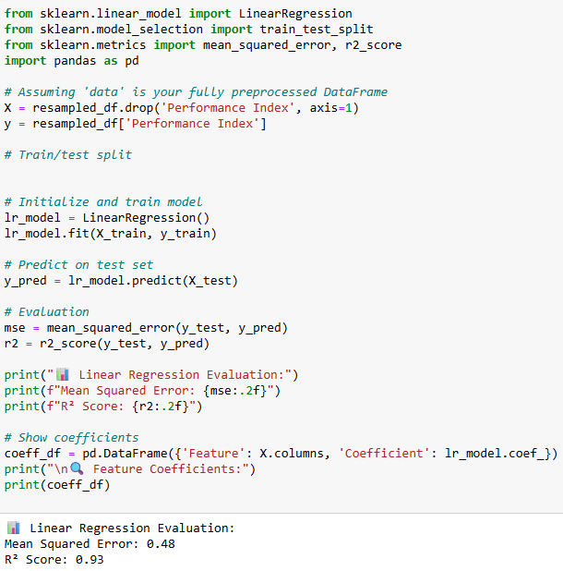
Model Training & Evaluation Metrics
After setting up our model, the next step was to train and thoroughly evaluate its performance. We generated predictions on the test set using lr_model.predict(), providing the basis for our assessment. The model's accuracy and error margin were quantitatively evaluated using Mean Squared Error (MSE) and R² Score. A remarkably high R² value of approximately 0.93 indicates strong predictive power, while the MSE offered precise insight into the deviation of predictions from actual values. Furthermore, we closely examined feature importance through regression coefficients, understanding each variable's contribution to the predicted performance.
0.93
Low
High
R² Score
MSE Value
Feature Importance
Indicates strong predictive power.
Demonstrates minimal deviation from actuals.
Understood through regression coefficients.

Slide 7
Graphs & Visualizations
Visualizations played a critical role in understanding our data and validating preprocessing steps. Boxplots were extensively used to confirm the effective removal of outliers from numerical columns, ensuring clean data for training. Principal Component Analysis (PCA) was employed for dimensionality reduction, allowing us to visualize the data distribution in a more interpretable 2D space, which clearly showed how well data clustered without outliers. Distribution plots further validated our data normality assumptions crucial for regression. Additionally, a comprehensive feature-target correlation matrix was generated, providing clear insights into the influence of each variable on the target performance index.
Boxplots
Visualize and confirm outlier removal in numerical columns.
PCA Plots
Reduce dimensionality and visualize data distribution and clustering.
Distribution Plots
Validate data normality assumptions for regression analysis.
Correlation Matrix
Understand the influence of variables on the target performance.

Slide 8
Conclusion
We successfully developed and rigorously evaluated a regression model for predicting student performance, achieving a high R² score that confirms its strong predictive capabilities. The insights gained can significantly aid educators in proactive decision-making for student support and resource allocation. For future enhancements, we propose integrating advanced validation techniques like cross-validation and exploring more sophisticated models such as RandomForest or XGBoost to potentially improve accuracy further. Ultimately, our goal is to deploy this model into educational platforms for real-time student analysis and to enrich it with psychological or socio-economic features for deeper, more holistic insights into student success.
Key Achievement
Immediate Impact
Successfully built and evaluated a regression model for student performance prediction.
Findings can assist educators in proactive decision-making for student support.
Next Steps
Future Enhancements
Apply cross-validation, explore advanced models, and deploy for real-time analysis.
Incorporate psychological or socio-economic features for better insights.

